Slide 1
Module 2
Word Level Analysis

Slide 2
Why is word Level Analysis ?
NLP has various levels and complexity of Processing. One technique to analyse natural language text is breakdown the text into constituent units like words, phrases, sentences and paragraphs and after that analyses these units.
It is important to analyse the words before analysing the syntax because the words are the fundamental unit.
This chapter is focusing on NLP performed at word level, that incorporates characterizing word sequences, recognising morphological variants, detecting the misspelled words and correcting them and recognising the precise part of speech of a word

Slide 3
Tokenization (Imp)
Tokenization is the process of braking down raw text into smaller meaningful lexical units.
Tokenization divides raw text into words and phrases known as tokens.
These tokens aid in understanding the context or constructing the NLP model. Tokenization aids in determining the meaning of the text by evaluating the word sequence.
For example, the sentence "It is raining" may be tokenized into 3 tokens: "It," "is," and "raining.“
When text is broken into words using a separation approach, this is referred to as word tokenization, and when this is done for sentences, it is referred to as sentence tokenization.

Slide 4
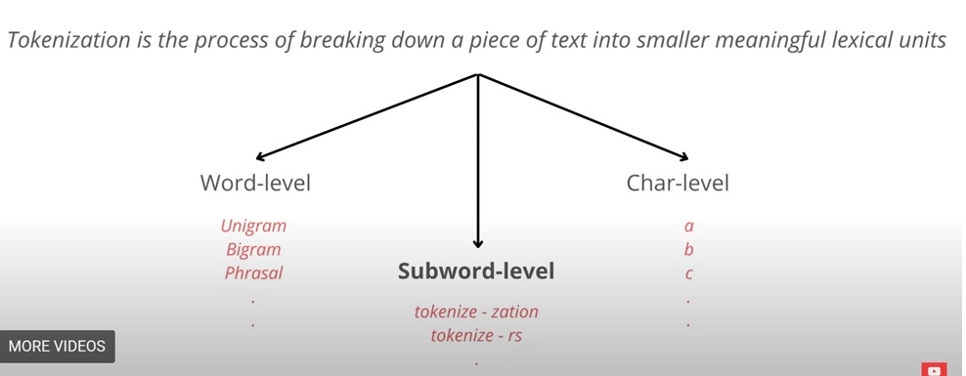
Tokenization

Slide 5
Tokenization
Stop words are words in the text that add no sense to the phrase and removing them will not influence the processing of text for the specified purpose.
They are deleted from the lexicon to minimise noise and the feature set's dimension.

Slide 6
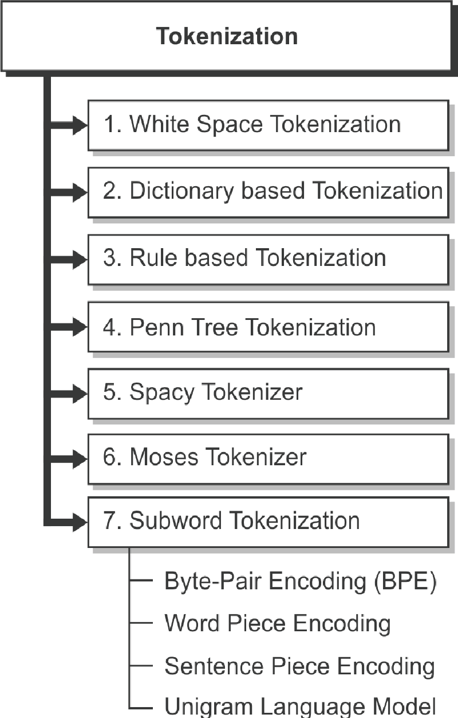
Approaches of Tokenization (Imp)
White space tokenization
Dictionary based Tokenization
Rule based tokenization
Penn Tree tokenization
Spacy tokenization
Moses tokenization
Subword tokenization

Slide 7
Approaches of tokenization
1. White Space Tokenization
This is the simplest tokenization technique.
Given a sentence or paragraph it tokenizes into words by splitting the input whenever a white space in encountered.
This is the fastest tokenization technique but will work for languages in which the white space breaks apart the sentence into meaningful words. Example: English.
2. Dictionary Based Tokenization
Tokens are found using this approach depending on the tokens already in the dictionary.
If the token cannot be discovered, it is tokenized using specific criteria.
It is a more sophisticated approach than the whitespace tokenizer.

Slide 8
Approaches of tokenization
3. Rule Based Tokenization
This strategy involves developing a set of rules for a given situation.
Tokenization is performed in accordance with the requirements.
For example, defining grammar-based rules for a certain language.
4. Regular Expression Tokenizer
This approach uses regular expressions to regulate the tokenization of text.
Regular expressions may range from simple to sophisticated, and can be difficult to understand at times.
When the previous approaches fail to meet the requirements, this strategy should be used.
It is a tokenizer with rules.

Slide 9
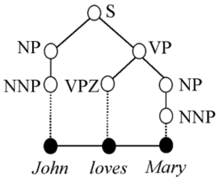
Approaches of tokenization
5. Penn TreeBank Tokenization
Tree bank is a corpus that was built to provide semantic and syntactical annotation of language.
Penn Treebank is one of the most extensive treebanks ever published.
This tokenization approach distinguishes punctuation, clitics (words that appear with other words, such as I'm, don't), and hyphenated words.
6. Spacy Tokenizer
This is a current tokenization strategy that is quick and easy to customize.
It allows you to define specific tokens that do not need to be divided or must be segmented using special criteria.
If you wish to maintain $ as a distinct token, you must prioritize it over other tokenization activities.
Tree Bank

Slide 10
Approaches of tokenization
7. Moses Tokenizer
This is a sophisticated tokenizer that existed prior to the introduction of Spacy.
The tokenizer included with the Moses toolkit. It separates punctuation from word —preserving special tokens such as URL or dates— and normalizes characters (e.g., quotes Unicode variants).
It is essentially a set of complicated normalization and segmentation logic that performs very well with structured languages like as English.

Slide 11
Approaches of tokenization
8. Subword Tokenization
This tokenization is highly beneficial for applications where subwords are important.
The most often used words are given unique ids in this method, while less frequently used terms are broken into sub words that best express the meaning independently.
If the term ‘few’ appears frequently in the text, it will be allocated a unique id, however ‘fewer’ and ‘fewest’, which are rare words and appear less frequently in the text, will be broken into sub words such as ‘few’, ‘er’, and ‘est’.
This assists the language model in avoiding learning fewer and fewest as independent terms. During training, this enables for the identification of unknown terms in the data set.

Slide 12
Approaches of tokenization
There are many forms of subword tokenization.
Byte-Pair Encoding (BPE)
Sentence Piece
Word Piece Encoding (WPE)
Unigram Language Model
We will discuss the most commonly used two methods (BPE) and Word Piece

Slide 13
Subword tokenization – BPE (Imp)
(a) Byte-Pair Encoding (BPE)
This approach is based on information theory and compression techniques.
For tokenization, BPE employs Huffman encoding, which means that it employs more embedding or symbols for less often used words and less symbols or embedding for more commonly used terms.
Bottom-up subword tokenization is a method used in BPE tokenization.
The process begins by dividing the input words into single Unicode characters, each of which corresponds to a symbol in the final vocabulary.
Find the most often occurring symbol pair in the current lexicon.
When you add this to your vocabulary, it grows by one.
Repeat steps ii and iii until the specified number of tokens are created or no new symbol
combinations exist with the desired frequency.

Slide 14
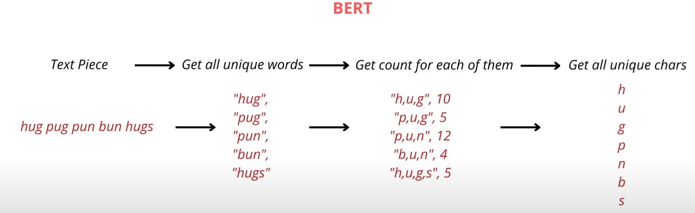
BPE(Byte Pair Encoding)

Slide 15
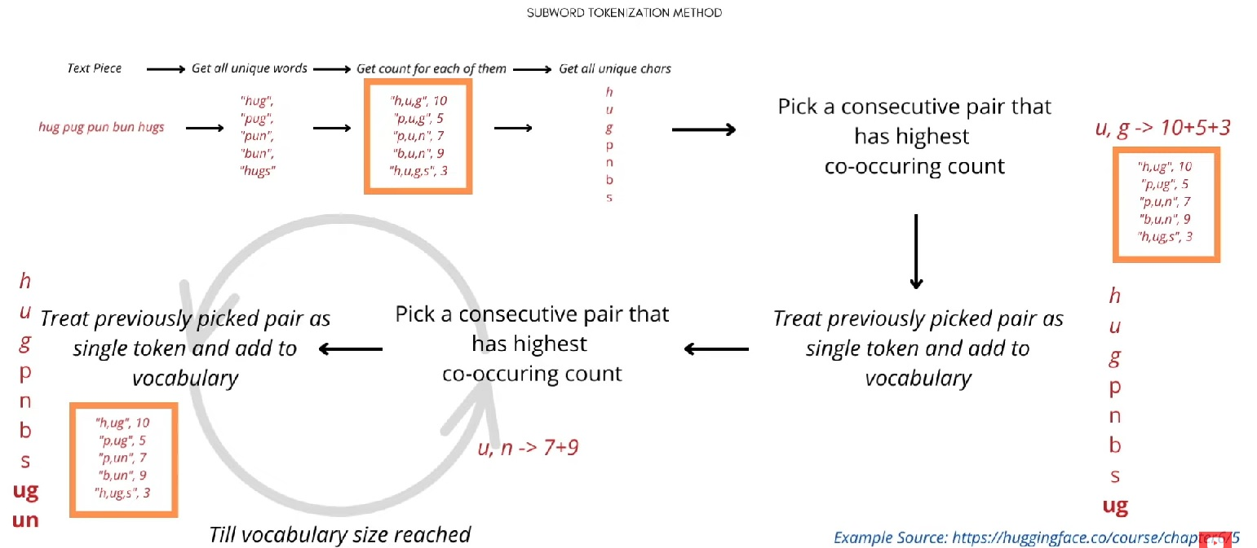
BPE(Byte Pair Encoding)

Slide 16
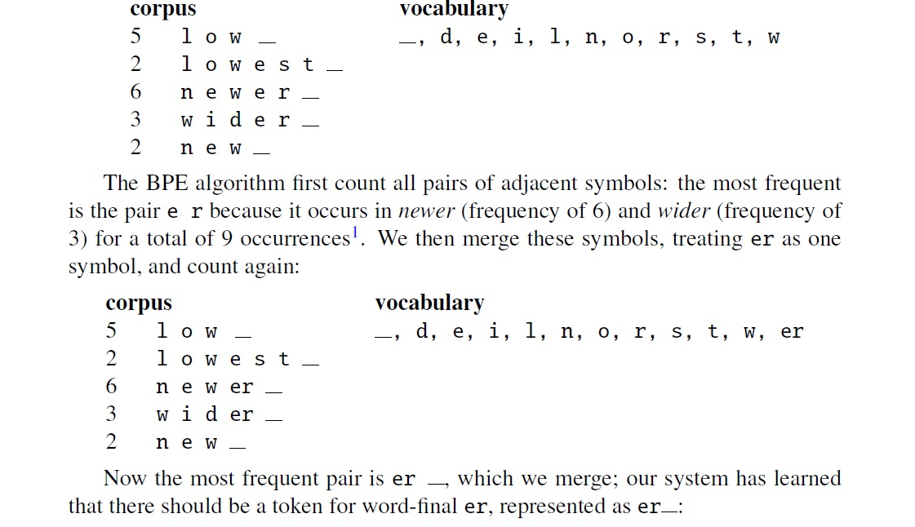
Another example (BPE)

Slide 17
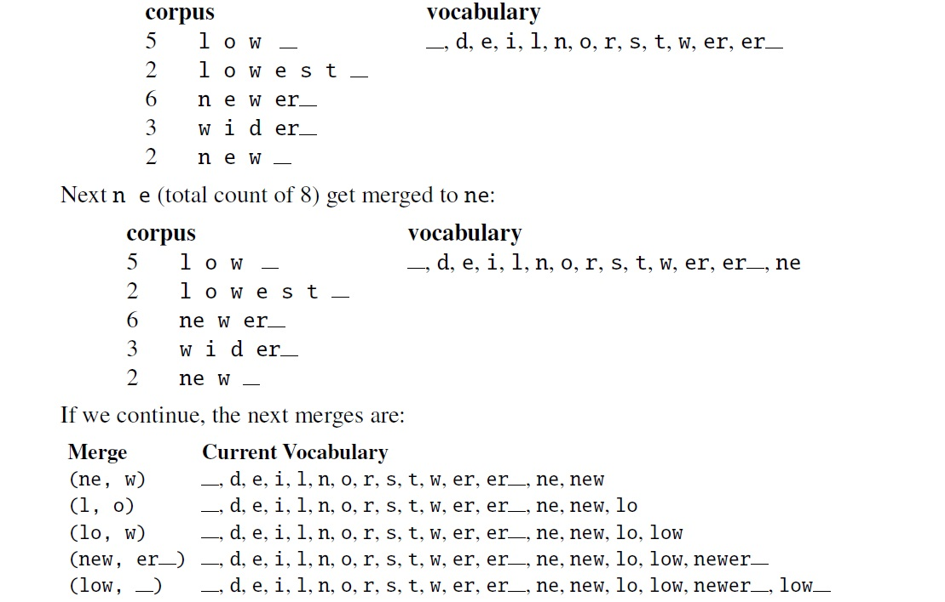
Once we’ve learned our vocabulary, the token parser is used to tokenize a test
sentence

Slide 18
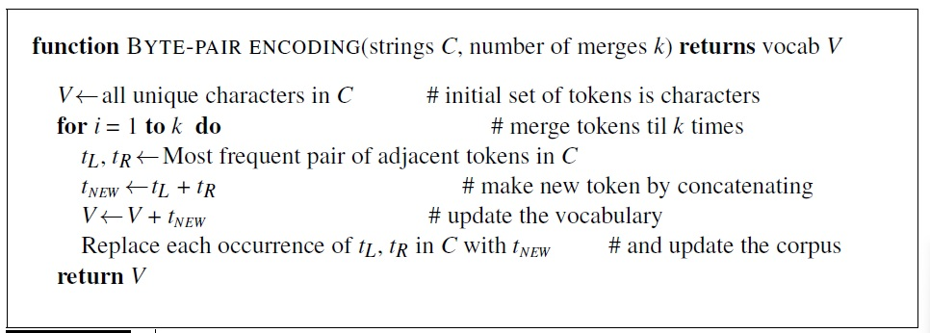
Algorithm - BPE

Slide 19
Subword tokenization- Word Piece Encodding
(b) Word Piece
Word Piece approaches are identical to BPE techniques except for how new tokens are introduced to the lexicon.
The token with the most often occurring pair of symbols is considered by BPE to integrate into the lexicon.
While Word Piece evaluates the frequency of specific symbols and blends them into the lexicon depending on the count shown below.
Count (x, y) = frequency of (x, y) / frequency (x) * frequency (y)
The symbol pair with the highest count will be evaluated for incorporation into vocabulary. As a result, unlike BPE, it permits unusual tokens to be incorporated in vocabulary.

Slide 20
Word Piece Tokenizer

Slide 21
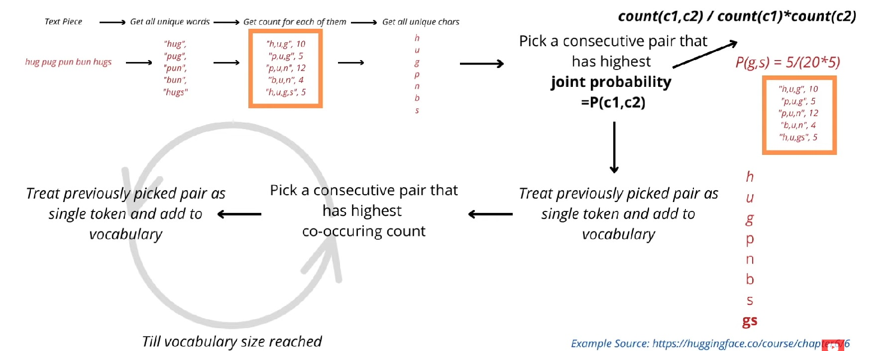
Word Piece Tokenizer

Slide 22
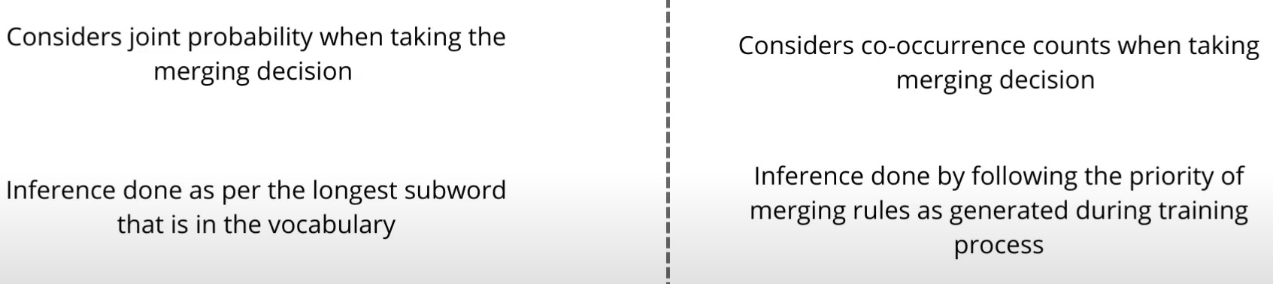
BPE Vs WPE
WPE
BPE

Slide 23
Segmentation
Text segmentation is the process of dividing written text into meaningful units, such as words, sentences, or topics.
Sentence segmentation is another important step in text processing.
The most useful cues for segmenting a text into sentences are punctuation, like periods, question marks, and exclamation points.
Question marks and exclamation points are relatively unambiguous markers of sentence boundaries. Periods, on the other hand, are more ambiguous.
The period character “.” is ambiguous between a sentence boundary marker and a marker of abbreviations like Mr. or Inc.
In general, sentence tokenization methods work by first deciding (based on rules or machine learning) whether a period is part of the word or is a sentence-boundary marker.
An abbreviation dictionary can help determine whether the period is part of a commonly used abbreviation; the dictionaries can be hand-built or machine learned.

Slide 24
Stemming and lemmatization (Imp)
“When we run a search in google, we would like to find relevant results not only for the exact expression we typed on the search bar, but also for the other possible forms of the words we ued.
For example, it’s very likely we will want to see results containing the form “shoot” if we Have typed “shoots” in the search bar.
This can be achieved through two possible methods:
Stemming
Lemmatization

Slide 25
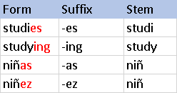
Stemming
The process of determining the root of words is known as stemming.
Stemming algorithms work by cutting off the end or the beginning of the word, taking into account a list of common prefixes and suffixes that can be found in an inflected word.
This indiscriminate cutting can be successful in some occasions, but not always, and that Is why this approach presents some limitation.

Slide 26
Stemming
We use Stemming to remove suffixes from words, resulting in a word stem.
For example, the phrases "likes," "likely," and "liked" all result in the common word stem "like," which may be used as a synonym for all three terms.
As a result, an NLP model can learn that all three terms are somehow related and are used in the same context.

Slide 27
Stemming
Stemming allows us to normalise words to their base stem regardless of inflection, which aids in numerous applications such as clustering and text classification.
Search engines make considerable use of these approaches to provide better results regardless of word form.
Prior to Google's introduction of word stems in 2003, a search for "fish" did not return websites about fishes or fishing.

Slide 28
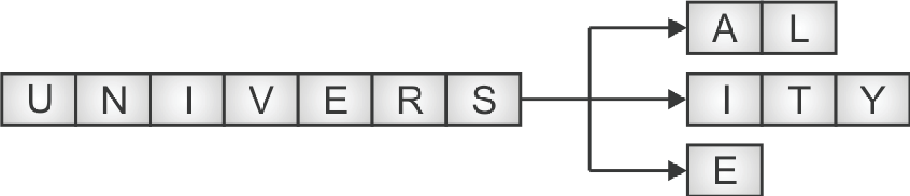
Over stemming
Over-stemming is the term we use to describe the process through which our algorithm stems many unrelated words to the same root
Despite sharing a core word and being related, the words "universal," "university," and "universe" have quite different meanings.
These terms should return quite distinct search results when we enter them into a reputable search engine, and they shouldn't be considered synonyms. Such a mistake is known as a false positive.

Slide 29
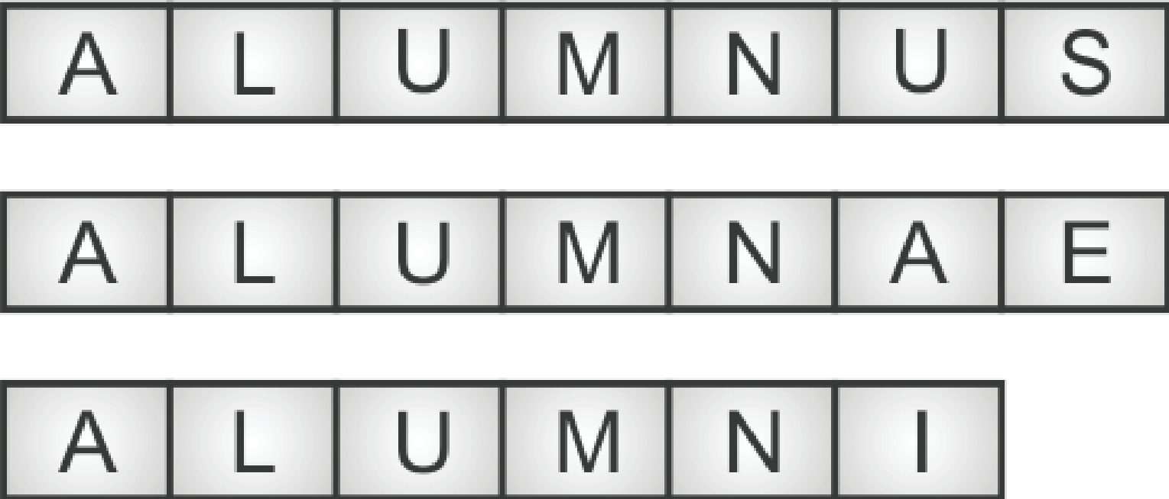
Under stemming
An under-Stemming, occurs when numerous words are not stemmed from a single root even when they should.
Under-stemming can lead to a loss of information and make it more difficult to analyze text.
A former university student is referred to as a "alumnus" and is often a male individual.
The word "alumni“ refers to several former students of an institution, whereas "alumnae" is the feminine equivalent.
DATA - > DAT
DATUM -🡪 DAT

Slide 30
Under stemming
To avoid under-stemming, it is important to use a stemmer that is appropriate for the task and language.
It is also important to test the stemmer on a sample of text to ensure that it is producing the correct root forms.
In some cases, using a lemmatizer instead of a stemmer may be a better solution as it takes into account the context of the word, making it less prone to errors.
Another approach to this problem is to use techniques like semantic role labeling, sentiment analysis, context-based information, etc. that help to understand the context of the text and make the stemming process more precise.

Slide 31
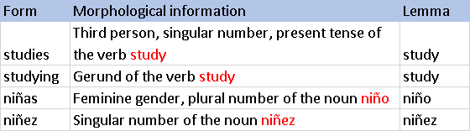
Lemmatization
Lemmatization, on the other hand, takes into consideration the morphological analysis of the words.
To do so, it is necessary to have detailed dictionaries which the algorithm can look through to link the form back to its lemma.

Slide 32
Lemmatization
If we try the word saw, stemming might return just ‘s’, but lemmatization would try to return either ‘see’ or ‘saw’ depending on whether the use of the token was as a verb or a noun.
In other words, Lemmatization is a technique responsible for grouping diverse inflected forms of words into the root form, having the similar meaning.
It is similar to stemming, but it provides the stripped word that has some dictionary meaning.
The Morphological analysis would need the mining of the accurate lemma of each word.

Slide 33
Stemming Vs. Lemmatization
 | Stemming | Lemmatization
1 | Stemming is faster because it chops words without knowing the context the word is given sentences | Lemmatization is slower as compared to stemming but is knows the context of the word before proceeding
2 | It is a rule based approach | It is a dictionary based approach.
3 | Accuracy is less | Accuracy is more as compared to stemming
4 | When we convert any word into root Form, then stemming may create the non-existence meaning of word | Lemmatization always gives the dictionary meaning word while converting into root form
5 | Stemming is preferred when the meaning of the word is not important of analysis Example : Spam detection | Lemmatization would be recommended when the meaning of the word is important for analysis. Example : Question
6 | For example : “Studies”=> “Studi” | For example : “Studies”=> “Study”

Slide 34
Morphological analysis
Morphological analysis is a field of linguistics that studies the structure of words.
It identifies how a word is produced through the use of morphemes.
A morpheme is a basic unit of the English language. The morpheme is the smallest element of a word that has grammatical function and meaning.
There are two types of morphemes:Free morpheme and bound morpheme .
A single free morpheme can become a complete word. For instance, a bus, a dog and so forth.
A bound morpheme, on the other hand, cannot stand alone and must be joined to a free morpheme to produce a word. ‘ing’, ‘un’, and other bound morphemes are examples.
Bound morphemes are sometimes referred as Affixes.
There are four types of affixes.
Prefixes – morphemes attached at the front of a stem ▪ Example: undo, disagree, uncommon etc.
Suffixes – morphemes attached at the end of a stem ▪ Example: hiding, attached, dogs etc.
Infixes – morphemes attached in between the stem ▪ Example: infix morphemes are rare and not present in English
Circumfixes – morphemes attached at the front and back of stem. example - unhappiness

Slide 35
Some important terminologies
Lexicon
It refers to the dictionary of words (stem/root word), their categories (noun, verb, adjective, etc.), their sub-categories (singular noun, plural noun, etc.) and the affixes that can be attached to these stems.
Orthographic rules
It refers to the spelling rules used in a particular language to model the spelling changes that occur in a word. For example, when a stem ‘cook’ is attached with the morpheme ‘ing’, it becomes a new valid word with the spelling ‘cooking’. What happened here was the concatenation of two strings. This is not true for all words. If we attach the morpheme ‘ing’ with the word ‘care’, the spelling changes to ‘caring’ rather than ‘careing’. In this case, it was not just concatenation but it also involved removal of the letter ‘e’.
Morphotactics
In a natural language, a word may have many morphemes attached to it as affixes (prefix, suffix, infix,
circumfix). Morphotactics is about placing morphemes with stem to form a meaningful word. It gives the details about which classes of morpheme can follow which other classes of morpheme. For example, in English language the plural morpheme (s or es) follows the stem.

Slide 36
Types of Morphology
Inflectional
Derivational

Slide 37
Inflectional Morphology
It is one of the ways to combine morphemes with stems.
Inflectional morphology conveys grammatical information, such as number, tense, agreement or case.
Due to inflectional morphological process, the meaning and categories of the new inflected words usually do not change.
That is, a noun can be inflected to a noun while adding affixes, a verb can be inflected to a verb in different tense in English.
We would say, the root word (stem) is inflected to form other words of same meaning and category.
Inflection creates different forms of the same word.
In English, only nouns and verbs can be inflected (sometimes adjectives too). Inflectional morphemes are very less when compared with some other languages

Slide 38
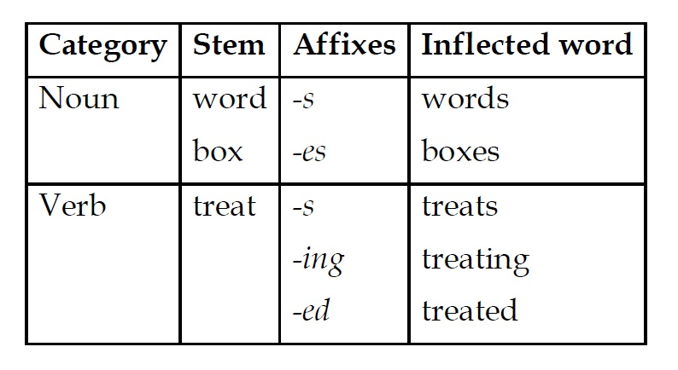
Example of inflected morphology
In the above example,the inflectional morpheme '-s' is combined with the noun stem 'word' to create plural noun 'words'. The inflectional morpheme '-ing' is combined with the verb stem 'treat' to create a gerund 'treating'.

Slide 39
Derivational Morphology
Derivation is the process of creating new words from a stem/base form of a word.
One of the most common ways to derive new words is to combine derivational affixes with root words (stems).
The new words formed through derivational morphology may be a stem for another affix.
English derivation is one of the complex derivations. It is because of one or more of the following reasons.

Slide 40
Less productive. That is, a morpheme added with a set of verbs to make new meaningful words cannot always be added with all verbs. For example, the base word 'summarize' can be added with the grammatical morpheme '-ation' results in a word 'summarization' whereas this morpheme cannot be added with all the verbs to make similar effects.
Complex meaning differences among nominalizing suffixes. For example, the words 'conformation' and 'conformity' both derived from the word stem 'conform' but meanings are entirely different.
Derivation creates different words from the same lemma.

Slide 41
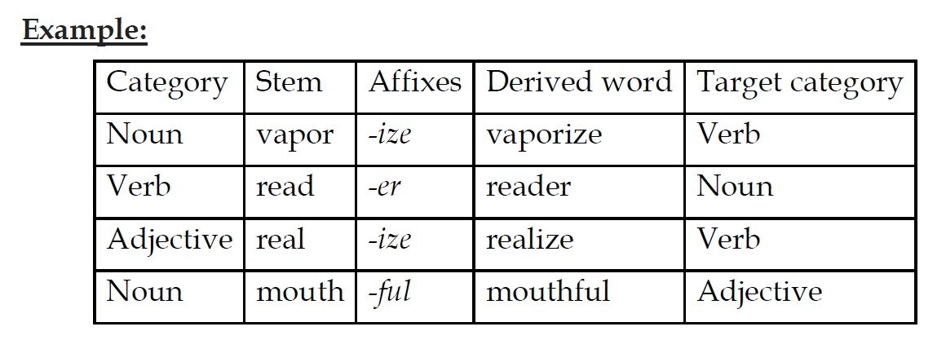
Example: Derivational morphology

Slide 42
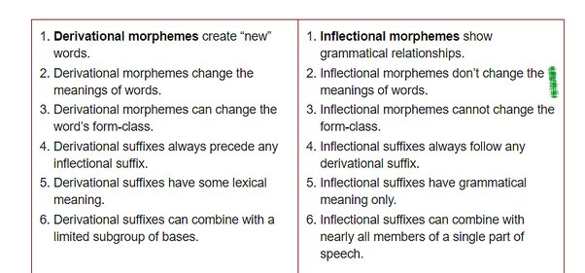
Derivational Vs. Inflectional Merphemes

Slide 43
Regular Expression with Types

Slide 44
Regular expressions are also called as regexes. It is used for pattern matching standards for
string passing and replacement.
Regular expressions are powerful way to find and replace string that take a defined format. For
example, regular expressions are used to parse email addresses, URL’s, dates, log files,
configuration file, command line, programming script or switches.
Regular expression is a useful tool to design language compilers as well as they are used in
natural language processing for tokenization, describing lexicons, morphological analysis, etc.
Many of us have used simple form of regular expression for searching file patterns in MS DOS
for example dir*.txt.

Slide 45
The simple type of regular expression contains a single symbol.
For example the expression : /a/ - The expression denotes a set containing a string ‘a'.
It also pacifies sequence of characters.
For example : /avengers/ - It denotes Indian notes that contain screen avengers and nothing
else.
Brackets : Characters are group by putting them between square brackets. This way any
character in the class will match One character in the input.
For example,
/[abcd]/ will match any of a, b, c, and d.
/ [0123456789]/ specifies any single digit.

Slide 46
Range : Sometimes regular expression led to cumbersome notation.
For example:
/[abcdefghijklmnopqrstuvwxyz] - It specifies any lowercase letter.
In such cases a dash is used to specify a range.
For Example :
/ [3-6]/ specifies any one of the digits 3,4,5, or 6.
T /[c-f]/ specifies any one of the letter c,d,e, or f.

Slide 47
Caret^ : The caret is used at the beginning of the regular expression to specify what a single
character cannot be.
For example :
/[^x] - matches any single character except x
/[ˆA-Z]/ --> not an upper-case letter
/[ˆTt]/ --> neither ‘T’ nor ‘t’
/[ˆ\.]/ --> not a period
/[pˆ]/ --> either ‘p’ or ‘ˆ’
/xˆy/ --> the pattern ‘xˆy’

Slide 48
Regular expressions are case sensitive. the pattern /t/ matches t but not T. It means pattern
/Tree/ will not match pattern/tree/. To solve this issue the regular expression for this is written
as / [Tt]ree/.
* or + : The use of * or + allows you to add 1 or more of a preceding character.
For example:
oo*h! → 0 or more of a previous character (e.g. ooh!,ooooh!)
o+h! → 1 or more of a previous character (e.g. ooh!,ooooooh!)
paa+ →paa, paaaa, paaaaaa, paaaaaaa
? : The question mark ? letters optionality of the previous expression.
For example :
/woodchucks?/ --> woodchuck or woodchucks
/colou?r/ --> color or colour

Slide 49
Anchor: These are special characters to accomplish string operations at the start and end of a
text input.
‘^’ — specifies the start of the string. The character followed by the ‘^’ in the pattern should
be the first character of the string in order for a string to match the pattern.
‘$’ — specifies the end of the string. The character that precedes the ‘$’ in the pattern should
be the last character in the string in order for the string to match the pattern.

Slide 50
The following are some special characters:
. → any character except a new line
\\w → any word character
\\W → anything but a word character
\\d → any digit character
\\D → anything but a digit character
\\b → a word boundary
\\B → anything but a word boundary
\\s → any space character
\\S → anything but a space character

Slide 51
Morphological Models

Slide 52
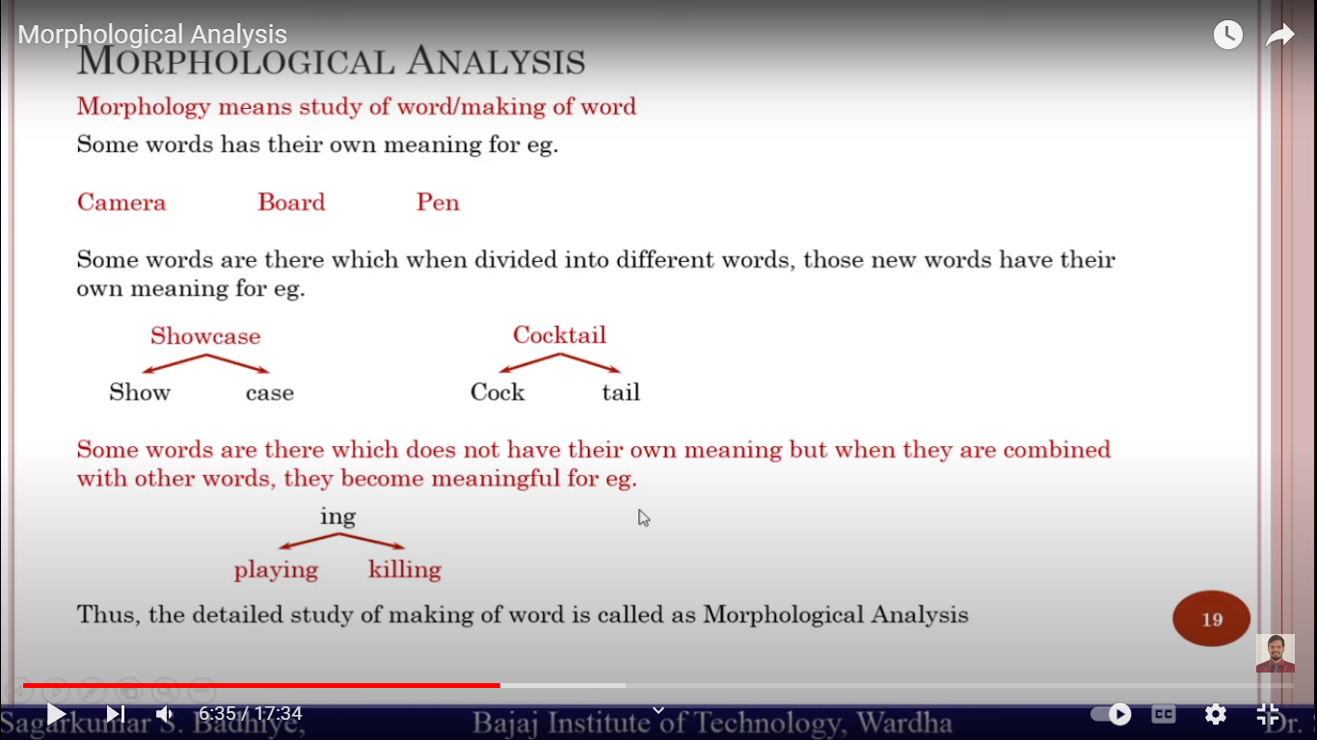

Slide 53
Dictionary Lookup
This method of word representation is the simplest method
all the words we saw are compiled into a dictionary, and the index of those words is the number we are interested in.
Sentence 1 : The fool doth think he is wise, but the wise man knows himself to be a fool.
After completing the pre-processing procedures necessary for the use-case, distinctive terms are listed.
Any word may now easily be represented numerically by looking it up in the dictionary.
Although it is a straightforward procedure, it has a serious drawback.
Each word is given an integer value using this procedure. Therefore, a deep learning model
would believe that a word with a higher integer value is somehow more significant than a word
with a lower integer value when given these word representations as input. However, we are
aware that this is false and that all words must be given the same weight.

Slide 54
Finite State Morphology
An automaton having a finite number of states is named a Finite Automaton (FA) or Finite State automata (FSA).
Finite automata are used to identify patterns. It takes the string of symbol as input and changes its state accordingly. When the required symbol is found, then the transition happens.
When transition takes place, the automata can either move to the succeeding state or stay in the similar state. There are two states in Finite automata: Accept state or Reject state.
When the input string is processed successfully, and the automata reached its final state, then it will accept it or reject it.

Slide 55
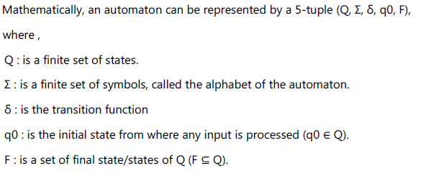
Finite State Morphology
There are two types of Finite Automata
1. Deterministic Finite automation (DFA)
2. Non-deterministic Finite Automation (NDFA)

Slide 56
Deterministic Finite Automation (DFA)
Definition : It may be defined as the type of finite automation wherein, for every input symbol
we can determine the state to which the machine will move. It has a finite number of states that
is why the machine is called Deterministic Finite Automaton (DFA).
Mathematically, a DFA can be represented by a 5-tuple (Q, Σ, δ, q0, F),
Where,
Q : is a finite set of states.
Σ : is a finite set of symbols, called the alphabet of the automaton.
δ : is the transition function where δ: Q × Σ → Q.
q0 : is the initial state from where any input is processed (q0 ∈ Q).
F : is a set of final state/states of Q (F ⊆ Q).

Slide 57
Deterministic Finite Automation (DFA)
However, graphically a DFA can be represented by diagraphs called state diagrams
where ,
Vertices It represents states
Labeled arcs It represents transitions
Empty incoming arc It represents initial state
Double circle It represents final state
Example :
Σ = {0, 1},
Q = {q0,q1,q2,q3,q4},
start state is q0 and final state is q4.

Slide 58
Deterministic Finite Automation (DFA)
The following are the rules for transition.
1. from state q0 and with input a go to state q1
2. from state q1 and with input b go to state q2
3. from state q1 and with input c go to state q3
4. from state q2 and with input b go to state q4
5. from state q3 and with input b go to state q4

Slide 59
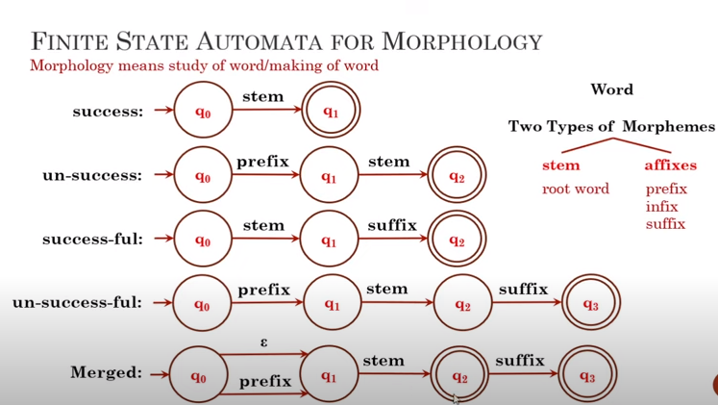

Slide 60
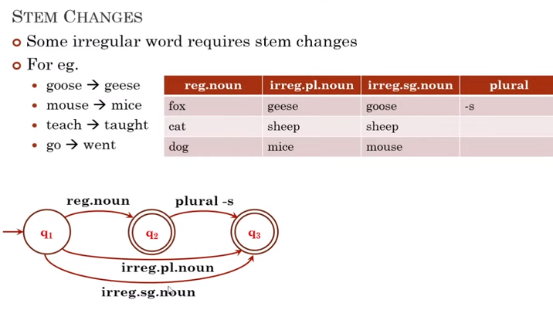

Slide 61
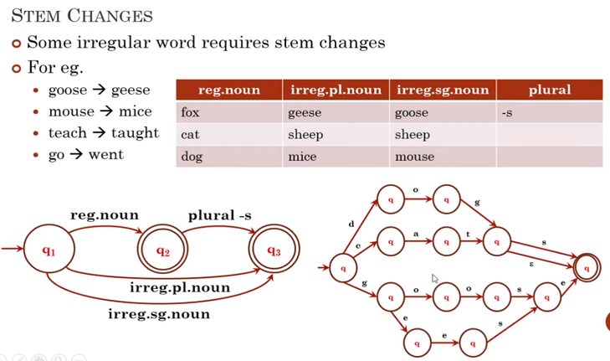

Slide 62
Non-deterministic Finite Automation (NDFA)
Definition : Non-deterministic Finite Automation is defined as the type of finite automation
where for each input symbol we cannot determine the state to which the machine will move
i.e., the machine can move to any combination of the states.
It means for each state there can be more than one transition on a given symbol, each lead to a different state. It has a finite number of states due to this the machine is called Non-deterministic Finite Automation.
Mathematically, NDFA can be given by a 5-tuple (Q, Σ, δ, q0, F),
Where,
Q : is a finite set of states.
Σ : is a finite set of symbols, called the alphabet of the automaton.
δ : is the transition function where δ: Q × Σ → 2 Q.
q0 : is the initial state from where any input is processed (q0 ∈ Q).
F : is a set of final state/states of Q (F ⊆ Q)

Slide 63
Non-deterministic Finite Automation (NDFA)
Graphically the NDFA is represented same as DFA. Consider the same example of DFA.
There are two possible transitions from state q0 input symbol a. The transition diagram
for NDFA is as shown in Fig.

Slide 64
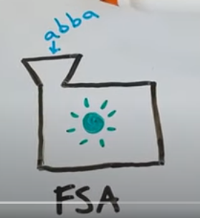
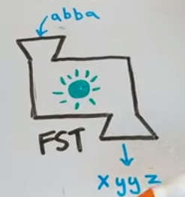
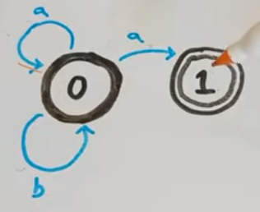
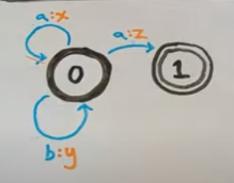
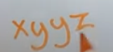

Slide 65
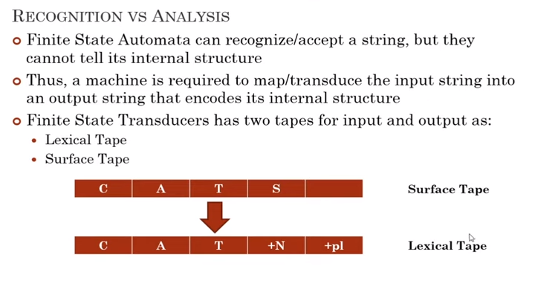

Slide 66
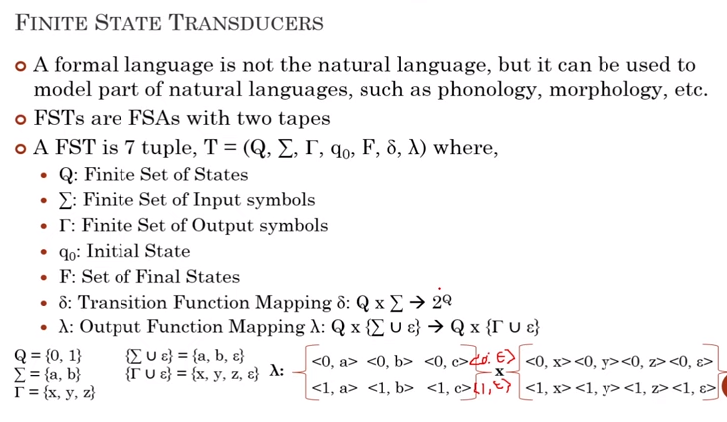

Slide 67
Finite State Transducer
The FST is a multi-function device, and can be viewed in the following ways:
o Translator : It reads one string on one tape and outputs another string,
o Recognizer : It takes a pair of strings as two tapes and accepts/rejects based on their
matching.
o Generator : It outputs a pair of strings on two tapes along with yes/no result based on
whether they are matching or not.
o Relater : It computes the relation between two sets of strings available on two tapes

Slide 68
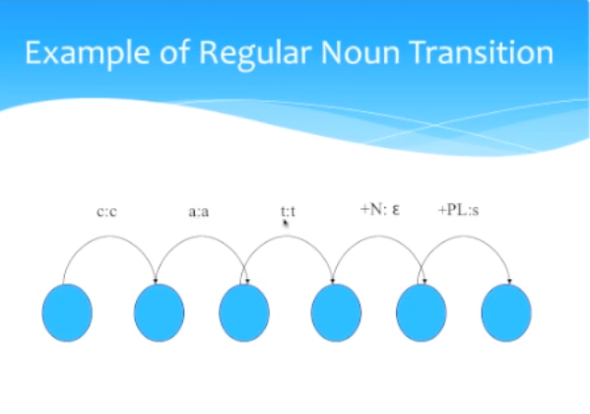

Slide 69
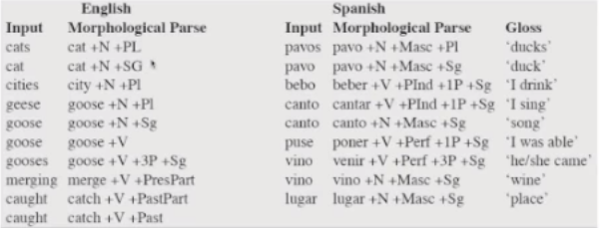

Slide 70
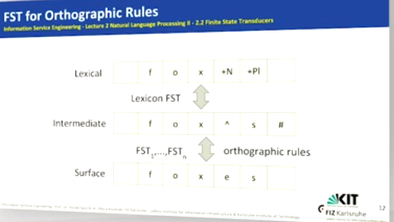

Slide 71
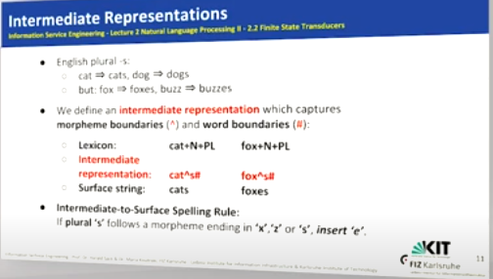

Slide 72
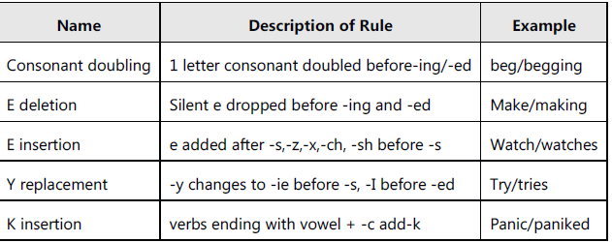
Orthographic Rules

Slide 73
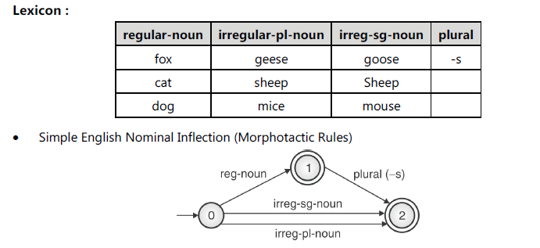
lexicon

Slide 74
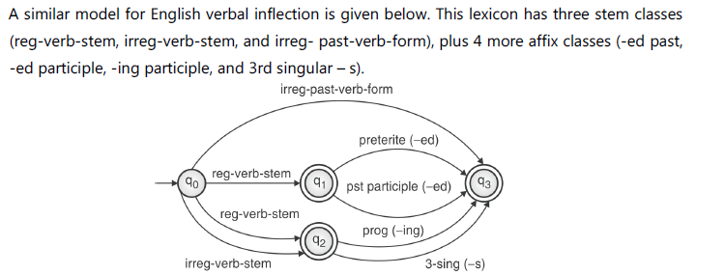

Slide 75
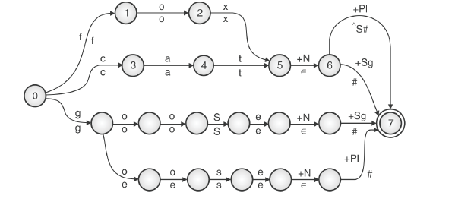

Slide 76
N-Gram Language Model

Slide 77
N-Gram Language Model (Imp)
N-gram can be defined as the contiguous sequence of 'n' items from a given sample of text or speech. The items can be letters, words, or base pairs according to the application.
Consider the following example: "I love reading books about Machine Learning on BackkBenchers Community”.
A 1-gram/unigram is a one-word sequence. For the given sentence, the unigrams would be: "I", "love", "reading", "books", "about", "Machine", "Learning", "on", "BackkBenchers", "Community".

Slide 78
N-Gram Language Model
A 2-gram/bigram is a two-word sequence of words, such as "I love", "love reading" or "BackkBenchers Community".
A 3-gram/trigram is a three-word sequence of words like "I love reading", "about Machine Learning“ or "on BackkBenchers Community“.
In general, N-gram language model predicts the probability of a given N-gram within any sequence of words in the language.
A good N-gram model can predict the next word in the sentence i.e. the value of p(wlh) - what is the probability of seeing the word w given a history of previous word h - where the history contains n-1 words.

Slide 79
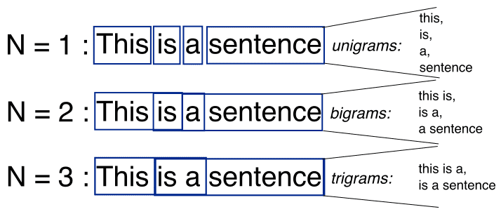
N-Gram Language Model

Slide 80
N-Gram Language Model
The estimation of probability of a sentence is achieved by decomposing sentence probability into a product of conditional probabilities.
We compute this probability in two steps:
1. Apply the chain rule of probability
2. Apply a very robust simplification assumption to let us to compute p(w1…ws) in an easy manner.

Slide 81
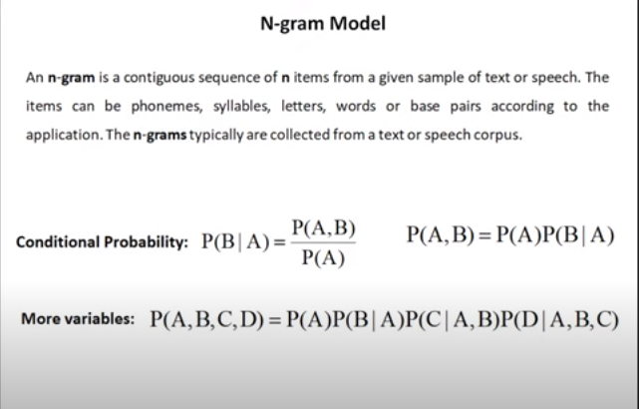

Slide 82
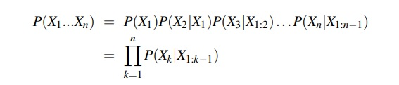
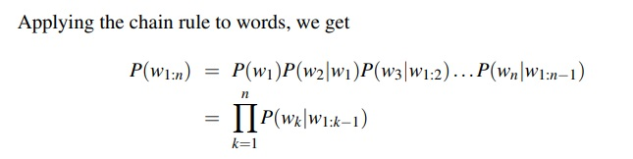
Now, how can we compute probabilities of entire sequences like P(w1,w2,...,wn)?
One thing we can do is decompose this probability using the chain rule of probability
Example of chain rule:
P('There was heavy rain') = P('There', 'was', 'heavy', 'rain') = P('There')P('was'|'There')P('heavy'|'There was')P('rain'|'There was heavy')

Slide 83
We don’t know any way to compute the exact probability of a word given a long sequence of preceding words, P(wn|w1:n−1).
The intuition of the n-gram model is that instead of computing the probability of a word given its entire history, we can approximate the history by just the last few words.
The bigram model, for example, approximates the probability of a word given all the previous words P(wn|w1:n−1) by using only the conditional probability of the preceding word P(wn|wn−1). In other words, instead of computing the probability.
P(the|Walden Pond’s water is so transparent that) we approximate it with the probability P(the|that).
When we use a bigram model to predict the conditional probability of the next word, we are thus making the following approximation:
P(wn|w1:n−1) ≈ P(wn|wn−1)

Slide 84
Markov Assumption of N-Gram model
The assumption that the probability of a word depends only on the previous word is Markov called a Markov assumption.
Markov models are the class of probabilistic models that assume we can predict the probability of some future unit without looking too far into the past.
We can generalize the bigram (which looks one word into the past) n-gram to the trigram (which looks two words into the past) and thus to the n-gram (which looks n−1 words into the past).

Slide 85
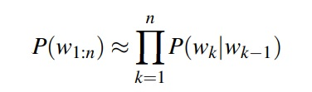
Let’s see a general equation for this n-gram approximation to the conditional probability of the next word in a sequence.
We ‘N’ here to mean the n-gram size, so N = 2 means bigrams and N = 3 means trigrams. Then we approximate the probability of a word given its entire context as follows:
P(wn|w1:n−1) ≈ P(wn|wn−N+1:n−1)
Given the bigram assumption for the probability of an individual word, we can compute the probability of a complete word sequence

Slide 86
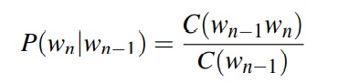
How do we estimate these bigram or n-gram probabilities?
Probabilities are estimated using maximum likelihood estimation or MLE.
We get the MLE estimate for the parameters of an n-gram model by getting counts from a corpus, and normalizing the counts so that they lie between 0 and 1.
For example, to compute a particular bigram probability of a word wn given a previous word wn−1, we’ll compute the count of the bigram C(wn−1, wn) and normalize by the sum of all the bigrams that share the same first word wn−1:

Slide 87
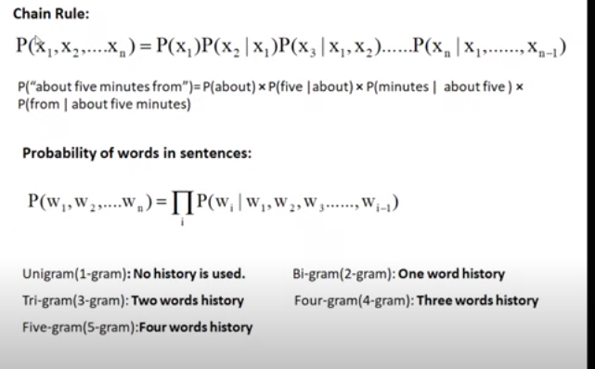

Slide 88
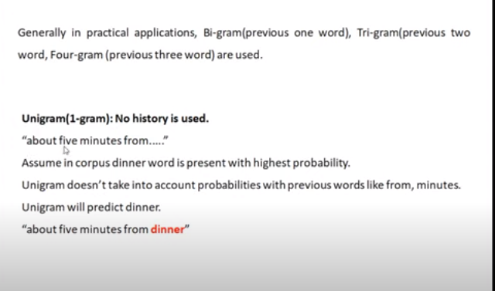

Slide 89
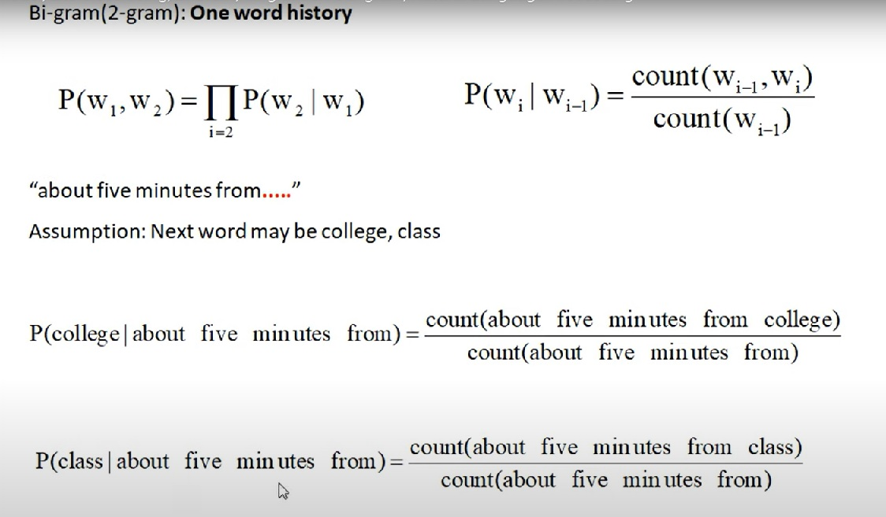
More Examples:

Slide 90
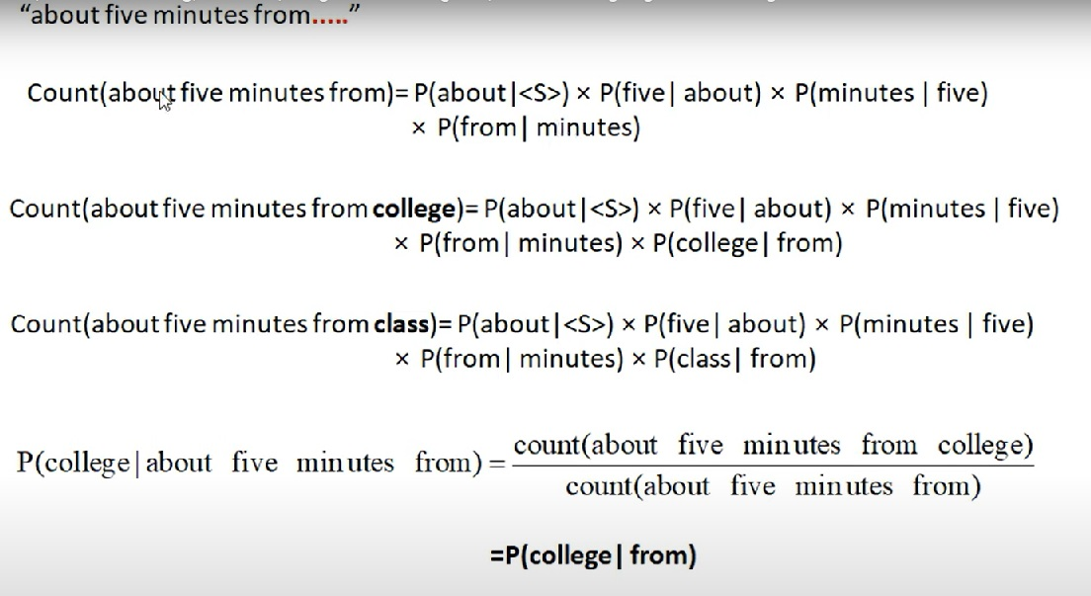
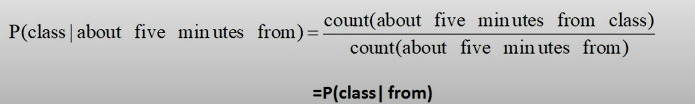

Slide 91
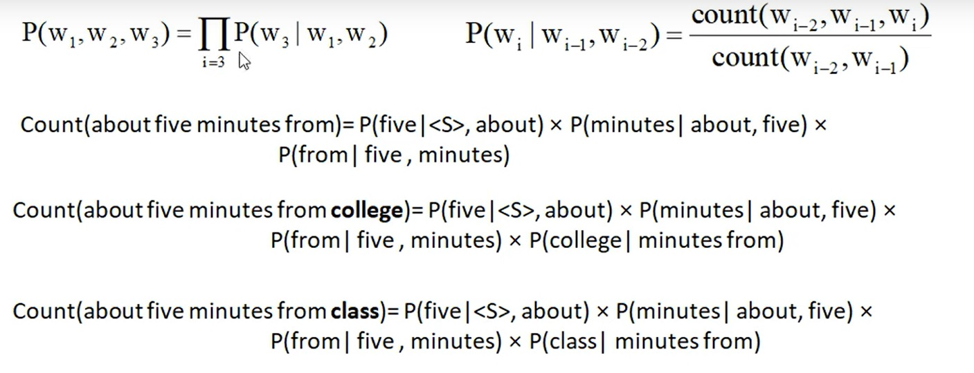
Tri Gram (Two words History)

Slide 92
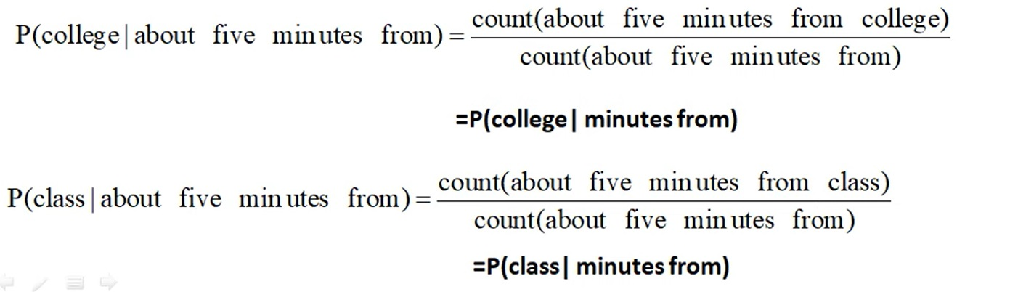

Slide 93


Four - Gram (Three word History)

Slide 94


Slide 95


Slide 96
Example of N-gram probabilities
<s> I am Sam </s>
<s> Sam I am </s>
<s> I do not like green eggs and ham </s>
P(I |<S>) = C ( <S> ,I) / C (<S>) = 2 / 3 = 0.67
P (am | I ) = C(I , am) / C (I) = 2 / 3 = 0.67
P (Sam |<S> ) = C (<S>, Sam) / C (<S>) = 1 / 3 = 0.33
P(</S>|Sam) = 1/2 = 0.5
P(Sam|am) = 1 /2 = 0.5
P(do|I) = 1/ 3 = 0.33

Slide 97


Slide 98


Slide 99


Slide 100


Slide 101


Slide 102


Slide 103

Solved Numerical - N-Gram

Slide 104


Question: which statement is most probable
I like college
Do I like Henry
find probability of both the sentences:
Answer : So, First statement is more probable

Slide 105
Tri gram , 4 - gram and 5 –gram
Although for pedagogical purposes we have only described trigram bigram models, in practice it’s more common to use trigram models, or 4-gram or even 5-gram 5-gram models, when there is sufficient training data.
Note that for these larger ngrams, we’ll need to assume extra contexts to the left and right of the sentence end.
For example, to compute trigram probabilities at the very beginning of the sentence, we use two pseudo-words for the first trigram.
<s><s> I am ….

Slide 106
Advantages of N-Gram Model
Disadvantages of N-Gram Model
Easy to understand and implement
Can be easily converted to any gram
Under flow due to multiplication of probabilities
Solution: Use Log and add probabilities
2. Zero probability problem
Solution : Use Laplace smoothing

Slide 107
Log Probabilities
We always represent and compute language model probabilities in log format as log probabilities.
Since probabilities are (by definition) less than or equal to log probabilities , the more probabilities we multiply together, the smaller the product becomes.
Multiplying enough n-grams together would result in numerical underflow.
By using log probabilities instead of raw probabilities, we get numbers that are not as small.
Adding in log space is equivalent to multiplying in linear space, so we combine log probabilities by adding them.
The result of doing all computation and storage in log space is that we only need to convert back into probabilities if we need to report them at the end; then we can just take the exp of the logprob:
p1 × p2 × p3 × p4 = exp(log p1 +log p2 +log p3 +log p4)

Slide 108
Solved Numerical - N-Gram using Log Probabilities

Slide 109

Answer : So, First statement is more probable

Slide 110
Smoothing
What do we do with words that are in our vocabulary (they are not unknown words) but appear in a test set in an unseen context (for example they appear after a word they never appeared after in training)?
To keep a language model from assigning zero probability to these unseen events, we use smoothing.
Smoothing is to add one to all the n-gram counts, before we normalize them into probabilities.
All the counts that used to be zero will now have a count of 1, the counts of 1 will be 2, and so on. This algorithm is called Laplace smoothing

Slide 111
Types of Smoothing
Types of smoothing:
Laplace (add-one) smoothing
add-k smoothing

Slide 112

Laplace Smoothing (or add one smoothing)
In Laplace smoothing we add one to all the n-gram counts, before we normalize them into probabilities.
All the counts that used to be zero will now have a count of 1, the counts of 1 will be 2, and so on. This algorithm is called Laplace smoothing.
Laplace smoothing merely adds one to each count. Since there are V words in the vocabulary and each one was incremented, we also need to adjust the denominator to take into account the extra V observations.

Slide 113

Example : Laplace Smoothing

Slide 114

In this case second statement has more probability and hence is more probable.

Slide 115

To overcome zero probability problem , we apply laplace smoothing.

Slide 116

Add one to the numerator and add count of no. of unique words to the denominator.
First statement is more probable

Slide 117

Example: Laplace smoothing
Word | Freq
<S> | 3
</S> | 3
I | 4
Am | 2
A | 2
human | 1
not | 1
stone | 1
live | 1
in | 1
Lahore | 1
Given a following corpus. Find which sentence is more probable 1. I am a human or 2. I am human (Apply laplace smoothing)

Slide 118
Bigram Probabilities without smoothing
Word | Freq
<S> | 3
</S> | 3
I | 4
am | 2
a | 2
human | 1
not | 1
stone | 1
live | 1
in | 1
Lahore | 1
p(I am a human) = P(I|<S>) P(am\I) P(a|am) P(human|a) P(</S>|human)
= 3/3 x 2/4 x 1 / 2 x 1/ 2 x 1/1 = 0.125
p(I am human) = P(I|<S>) P(am|I) (human|am) P(</S>|human)
= 3/3 x 2/4 x 0 / 2 x 1/1 = 0
Bigram Probabilities with Laplace smoothing
p(I am a human) = P(I|<S>) P(am|I) P(a|am) P(human|a) P(</S>|human)
= (3+1)/(3+10) x (2+1)/(4+10) x (1+1) / (2+10) x (1+1)/ (2+10) x (1+1)/(1+11) = 4/13 x 3/14 x 2/12 x 2/12 x 2/12 = 0.00183
p(I am human) = P(I|<S>) P(am|I) (human|am) P(</S>|human)
= (3+1)/(3+10) x (2+1)/(4+10) x (0+1) / (2+10) x (1+1) /(1+10)
= 4/13 x 3/14 x 1/12 x 2/12 = 0.00091

Slide 119

Add K smoothing
One alternative to add-one smoothing is to move a bit less of the probability mass from the seen to the unseen events.
Instead of adding 1 to each count, we add a fractional count -k
(.5? .05? .01?). This algorithm is therefore called add-k smoothing.
Add-k smoothing requires that we have a method for choosing k; this can be done, for example, by optimizing on a devset. Although add-k is useful for some tasks (including text classification), it turns out that it still doesn’t work well for language modeling, generating counts with poor variances and often inappropriate

Slide 120
Limitations of N-Gram model
The N-gram language model has also some limitations. There is a problem with the out of vocabulary words.
These words are during the testing but not in the training.
When implemented in the sentiment analysis, the bi-gram model outperformed the uni-gram model but the number of the features is then doubled.
So, the scaling of the N-gram model to the larger data sets or moving to the higher-order needs better feature selection approaches.
The N-gram model captures the long-distance context poorly. It has been shown after every 6-grams, the gain of performance is limited.

Slide 121
N-gram Sensitivity to the Training Corpus
The N-gram model, like many statistical models, is significantly dependent on the training corpus. As a result, the probabilities often encode particular facts about a given training corpus. Besides, the performance of the N-gram model varies with the change in the value of N.
Moreover, we may have a language task in which you know all the words that can occur, and hence we know the vocabulary size V in advance. The closed vocabulary assumption assumes there are no unknown words, which is unlikely in practical scenarios.

Slide 122
Evaluating the language model
There are two types of evaluation techniques for language model - Extrinsic and Intrinsic.
Extrinsic evaluation:
The easiest approach to assess a language model's performance is to embed it in an application and measure how much the application improves.
Extrinsic evaluation refers to such end-to-end evaluation.
Extrinsic assessment is the only way to determine whether a certain enhancement in a component will actually benefit the job at hand.
Thus, in the case of voice recognition, we may compare the performance of two language models by running the speech recognizer twice, once with each language model, and determining which yields the better accurate transcription.
Unfortunately, it may be highly expensive to run large NLP systems from beginning to finish

Slide 123
Intrinsic Evaluation:
In the context of Natural Language Processing (NLP), perplexity is a way to measure the quality of a language model independent of any application.
Perplexity measures how well a probability model predicts the test data.
The model that assigns a higher probability to the test data is the better model. [A good model will assign a high probability to a real sentence]
For example, let us assume that we estimate the probability of a test data using a bi-gram model and a tri-gram model. The better model among these is the one that has a tighter fit to the test data, or predicts the details of the test data better.
Lower the perplexity, higher the probability
Perplexity is an intrinsic evaluation metric (a metric that evaluates the given model independent of any application such as tagging, speech recognition etc.).

Slide 124



Slide 125
What is the value of N in this equation for a test set?
The test data can be a single sentence or a string consisting of multiple sentences. Since this is the case, we need to include sentence boundary markers <s> and </s> in the probability estimation. Also, we need to include the end of sentence marker </s>, if any, in counting the total word tokens N. [Beginning of the sentence marker not include in the count as a token.]

Slide 126
Example:Perplexity
Let's have a look at an illustration of how perplexity may be utilised to contrast several n-gram models.
Using a 19,979-word vocabulary, we trained unigram, bigram, and trigram grams on 38 million words from the Wall Street Journal.
We determined the perplexity of each of these models on a test set
of 1.5 million words.
According to each of these grammars, the perplexity of a 1.5-million-word WSJ test set is displayed in the Table

Slide 127


Slide 128


Slide 129


Slide 130
Edit Distance

Slide 131
Edit Distance
Many NLP tasks are concerned with measuring how similar two strings are.
For example consider Spell correction app: –
Suppose the user typed “graffe” – Which is closest? : graf, grail & giraffe. The word giraffe, which differs by only one letter from graffe, seems intuitively to be more similar than, say grail or graf.
Definition : The minimum edit distance between two strings is defined as the minimum number of editing operations (insertion, deletion, substitution) needed to transform one string into another.

Slide 132
What is edit distance?
Given two strings str1 and str2 and we can perform Insert, delete or replace operation on str1 to make str1 and str2 equal.
Minimum edit distance is to find minimum number of edits (operations) required to convert ‘str1’ into ‘str2’.
Example:
Str1 = “geeks”
Str2 = “gese”
In order to convert str1 into str2
We need to Replace ‘e’ by ‘s’ , replace ‘k’ by ‘e’ and delete last character ‘s’.
So minimum 3 operations need to performed.
Note that here we assume that all three operations are of same cost.

Slide 133

Example: Minimum Edit Distance
The minimum edit distance between ‘intention’ and ‘execution’ can be visualized using their alignment.
Given two sequences, an alignment is a correspondence between substrings of the two sequences
Where
D – deletion
S – substitution (replace)
I -insertion
We can also assign a particular cost or weight to each of these operations. The Levenshtein distance between two sequences is the simplest weighting factor in which each of the three operations has a cost of 1.
The Levenshtein distance between intention and execution is 5

Slide 134
Example: Minimum Edit Distance
Levenshtein also proposed an alternative version of his metric in which each insertion or deletion has a cost of 1 and substitutions are not allowed.
(This is equivalent to allowing substitution, but giving each substitution a cost of 2 since any substitution can be represented by one insertion and one deletion, substitution = delete + insert).
Using this version, the Levenshtein distance between intention and execution is 8.

Slide 135

Minimum Edit Distance Algorithm

Slide 136

Minimum Edit Distance (Levenshtein Distance) Algorithm

Slide 137
Example - Minimum Edit Distance
we are trying to convert “abcfg” to “adceg”
 | null | a | b | c | f | g
Null | 0 | 1 | 2 | 3 | 4 | 5
a | 1 | 0 | 1 | 2 | 3 | 4
d | 2 | 1 | 1 | 2 | 3 | 4
c | 3 | 2 | 2 | 1 | 2 | 3
e | 4 | 3 | 3 | 2 | 2 | 3
g | 5 | 4 | 4 | 3 | 3 | 2
Replace | Insert
Delete | Min(Replace, Delete, insert) +1
If x(i) == x(j)
Simply copy the diagonal element
D(I,j) = D(i-1 ,j-1)
Else
D(i,j ) = min [ D(I,j-1) , (D(-1, j) , D(i-1, j-1) ] +1
a | b | c | f | g
r
r
a | d | c | e | g

Slide 138
Compute minimum Edit Distance
Compute minimum Edit distance between string “abcdef” and “akcdg”
 | # | a | b | c | d | e | F
# | 0 | 1 | 2 | 3 | 4 | 5 | 6
a | 1 | 0 | 1 | 2 | 3 | 4 | 5
k | 2 | 1 | 1 | 2 | 3 | 4 | 5
c | 3 | 2 | 2 | 1 | 2 | 3 | 4
d | 4 | 3 | 3 | 2 | 1 | 2 | 3
g | 5 | 4 | 4 | 3 | 2 | 2 | 3
Answer : Minimum edit distance is 3
Note: assuming cost of all operations = 1 (Insert = delete = replace =1)

Slide 139


Slide 140
Compute Minimum Edit Distance
Compute minimum Edit distance between string “abcdef” and “akcdg”
 | # | a | b | c | d | e | F
# | 0 | 1 | 2 | 3 | 4 | 5 | 6
a | 1 | 0 | 1 | 2 | 3 | 4 | 5
k | 2 | 1 | 2 | 2 | 3 | 4 | 5
c | 3 | 2 | 3 | 2 | 3 | 4 | 5
d | 4 | 3 | 4 | 3 | 2 | 3 | 4
g | 5 | 4 | 5 | 4 | 3 | 4 | 5
Answer : Minimum edit distance is 5
Note: assuming cost Insert = delete = 1 and cost of replace =2

Slide 141
Edit Distance
 | NULL | E | X | E | C | U | T | I | O | N
NULL | 0 | 1 | 2 | 3 | 4 | 5 | 6 | 7 | 8 | 9
I | 1 | 1 | 2 | 3 | 4 | 5 | 6 | 6 | 7 | 8
N | 2 | 2 | 2 | 3 | 4 | 5 | 6 | 7 | 7 | 7
T | 3 | 3 | 3 | 3 | 4 | 5 | 5 | 6 | 7 | 8
E | 4 | 4 | 4 | 3 | 4 | 5 | 6 | 6 | 7 | 8
N | 5 | 5 | 5 | 4 | 4 | 5 | 6 | 7 | 7 | 7
T | 6 | 6 | 6 | 5 | 5 | 5 | 5 | 6 | 7 | 8
I | 7 | 7 | 7 | 6 | 6 | 6 | 6 | 5 | 6 | 7
O | 8 | 8 | 8 | 7 | 7 | 7 | 7 | 6 | 5 | 6
N | 9 | 9 | 9 | 8 | 8 | 8 | 8 | 7 | 6 | 5
Answer : Minimum edit distance is 5
Note: assuming cost of all operations = 1 (Insert = delete = replace =1)

Slide 142


Slide 143


Slide 144


Slide 145

D(i-1,j-1) | D(i-1 ,j)
D(i,j-1) | D(i , j )

Slide 146


Slide 147

D(i-1,j-1) | D(i-1 ,j)
D(i,j-1) | D(i , j )

Slide 148
Result of back trace

Slide 149


Slide 150

Example : Minimum edit distance
Note: assuming cost Insert = delete = 1 and cost of replace =2

Slide 151
Noisy channel models
The concept implies we begin with a pristine form of the signal that becomes damaged as it is transported across a medium that introduces noise, such as a defective telephone line –
Thus the name "noisy channel."
This is most easily understood for jobs involving real corrections, such as speech recognition or spelling correction.
For the latter, we suppose that we begin with a completely accurate version of the text, but that while typing it, we unwittingly add noise in the form of spelling mistakes. The aim is to get rid of the noise.

Slide 152

Noisy Channel

Slide 153


Slide 154


Slide 155


Slide 156


Slide 157


Slide 158


Slide 159


Slide 160


Slide 161


Slide 162


Slide 163


Slide 164


Slide 165


Slide 166

Channel model for acress

Slide 167


Slide 168


Slide 169


Slide 170


Slide 171

Evaluation

Slide 172
Problems based on Naive bayes (IMP)
Problem 1: A Naive Bayes text classifier has to decide whether the test document ‘Chennai Hyderabad’ belongs to class ‘India’ Or class ‘England’.
The following document collection is given:
 | Doc. No | Text | Class
Training set | 1 | Chennai Mumbai | India
 | 2 | Delhi London Hyderabad | England
 | 3 | Chennai Kolkata | India
 | 4 | Delhi Hyderabad pune | India
 | 5 | London Bristol Chennai | England
Test document |  | Chennai hyderabad | ??

Slide 173
Formula of Naive Bayes : P(A/B) = [P(A) . P(B/A) ] / P(B)
We need to find which probability is greater?
P (India | Chennai Hyderabad) = P(India) x P (Chennai Hyderabad |India)
or
P (England |Chennai Hyderabad) = P(England) x P (Chennai Hyderabad |England)The formula

Slide 174
Step 1: Calculate Prior probability
P(India) = 3 / 5
P(England) = 2 / 5
Step 2: Calculate conditional probabilities
P(word | Class)
P (Chennai Hyderabad |India) = P(Chennai|India) x P(Hyderabad | India)
P(Chennai|India) = 2/7 (Here 7 is the total no. of words in class india)
P(Hyderabad | India) = 1/7
P (Chennai Hyderabad |England) = P(Chennai | England) x P(Hyderabad | England)
P(Chennai | England) = 1 / 6 (Here 6 is the total no. of words in class England)
P(Hyderabad | England) = 1/6

Slide 175
Step 3: Calculate Posterior probabilities
P (India |Chennai Hyderabad) = P(India) x P (Chennai |India) P(Hyderabad |India)
= 3 / 5 x 2 / 7 x 1 /7 = 0.0245
P (England |Chennai Hyderabad) = P(England) x P (Chennai | England) P(Hyderabad | England)
= 2/ 5 x 1/6 x 1 / 6 = 0.0112
So, P (India | ‘Chennai Hyderabad’) > P (England | ‘Chennai Hyderabad’) hence test data belongs to class ‘India’

Slide 176

Problems based on Naive bayes (IMP)
Problem 2: A Naive Bayes text classifier has to decide whether the test document ‘Chinese Chinese Chinese Tokyo Japan’ belongs to class ‘C’ Or class ‘j’. Use Laplace Smoothing to avoid zero probabilities.
The following document collection is given:

Slide 177

Note: For laplace smoothing we add 1 to numerator and N (i.e total number of unique words in training set) to the denominator
Unique words in training set are = {Chinese, Beijing, Shanghai, tokyo,Japan, macao} = 6 so we add 6 to the denominator
answer: sense P(C|d5) > P(j|d5) the test document belongs to class ‘C’

Slide 178
Important theory questions
Q. 1 Explain Tokenization, Stemming, and Lemmatization?
Q. 2 Write the difference between Stemming, and Lemmatization.
Q. 3 Explain Inflectional Morphology, Derivational Morphology
Q. 4 Explain Regular expression with types?
Q. 5 Write short note on finite automata?
Q. 6 Explain Finite transducer?
Q. 7 Explain N-gram model?
Q. 8 Explain the variations of N gram model.
Q. 9 Explain Perplexity in detail?
Q. 10 What is Smoothing? Explain Laplace Smoothing.
Q. 11 Explain noisy channel model
Q no 12 Explain edit distance algorithm for spelling correction

Slide 179
Natural Language Processing. Title :- Morphological Analysis | by Raghvendra Zarkar | Medium
morphological analysis in nlp - Google Search
Morphological anlysis using Python code video - Google Search

Slide 180
END OF MODULE 2

